Slide 1
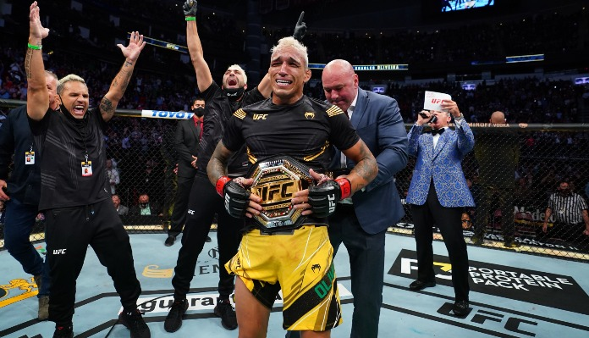
MMA League Table
Thomas Jubb

Slide 2

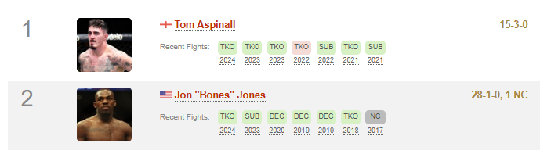

The Problem
*Tables for Mixed Martial Arts can be biased due to marketing or favouritism.
*It’s very time consuming to calculate the odds manually of a matchup.
*It’s hard to figure out what matchups are good to look forward to

Slide 3
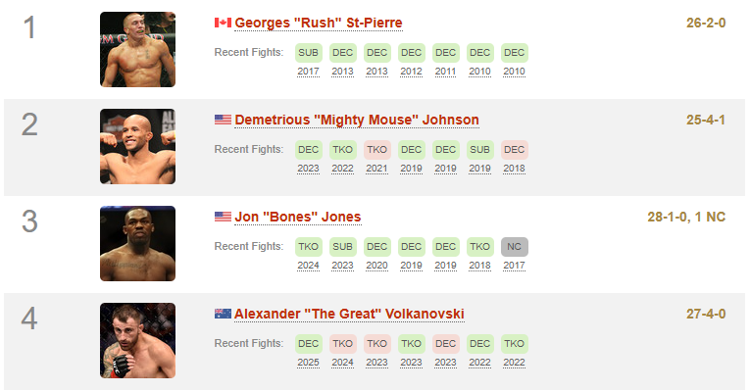
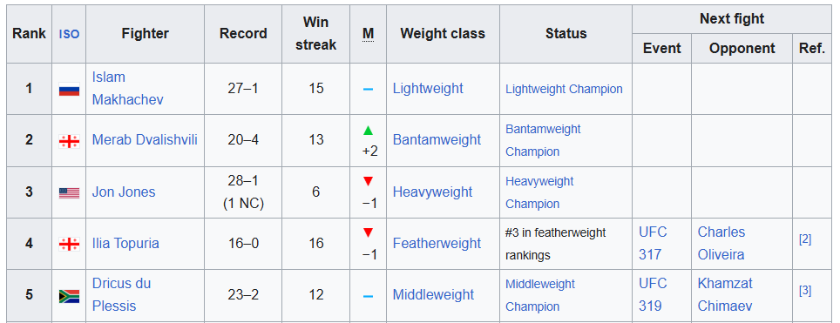
The Solution
*My program will:
- Have an admin panel to add fight data to a database
- Generate a pound for pound league table based off fight data
- This league table will be able to be sorted by nationality, discipline, weight class etc.

Slide 4
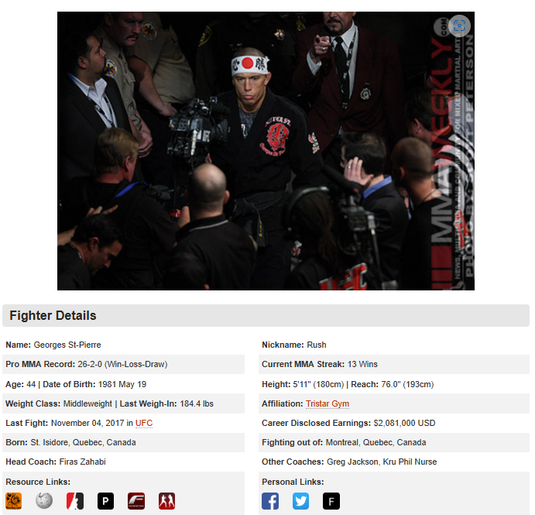
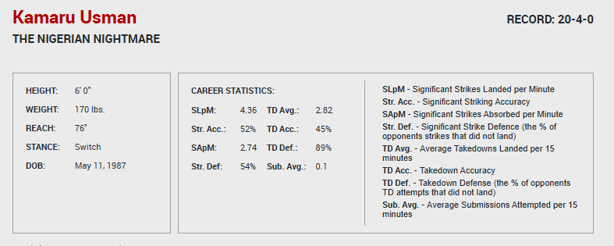
The Solution
Show the statistics of individual fighters

Slide 5
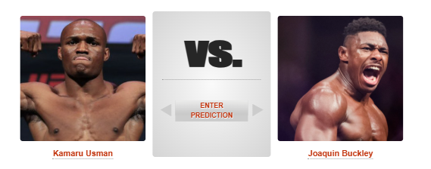

The Solution
Generate the best fights to watch out for based on fighter context

Slide 6
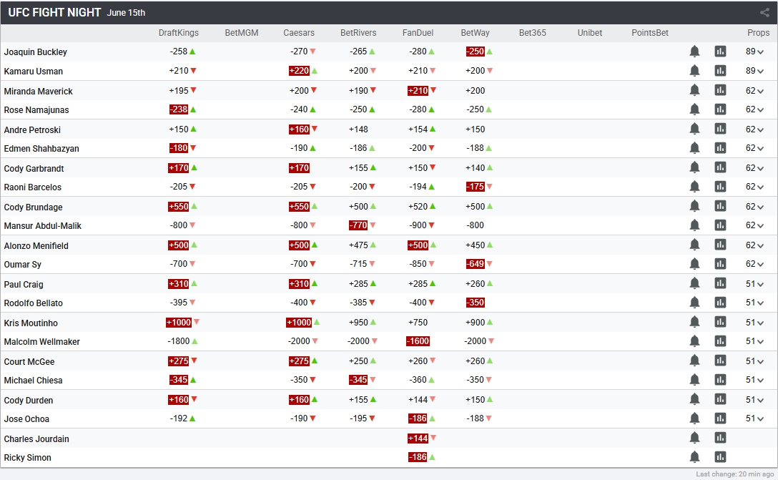
The Solution
Simulate a matchup and output the odds

Slide 7
The Limitations
*There are a few limitations to my idea:
- Data input might be tedious
- It’s hard to reliably calculate the odds to a fight
- The league table doesn’t matter to what fights the organisation wants to make

Slide 8
Thank you for listening

